Slide 1
Computer Networks I Data Link Control Protocols (Flow Control)
Amitangshu Pal
Computer Science and Engineering
IIT Kanpur

Slide 2
Data Link Layer
Data link layer has responsibility of transferring datagram from one node to physically adjacent node over a link
Framing
Encapsulate datagram into frame, adding header, trailer
Reliable delivery between adjacent nodes
Flow control and error control
Channel access if shared medium

Slide 3
Data Link Layer
Application
Application
Transport
Transport
datagram
Network
Network
link_{h}
datagram
Link
Link
datagram
Physical
Physical
Sending side:
Encapsulates datagram in frame
Adds error checking bits, reliable data transfer, flow control, etc.
Receiving side:
Looks for errors, reliable data transfer, flow control, etc.
Extracts datagram, passes to upper layer at receiving side

Slide 4


Data Link Layer
Application
Transport
Network
Link
CPU
Memory
host bus
(e.g., PCI)
Controller
Link layer implemented on-chip or in network interface card (NIC)
Implements link, physical layer
Attaches into host’s system buses
Combination of hardware, software, firmware
Link
Physical
Physical
Network interface

Slide 5
Flow Control

Slide 6
Flow Control
Application
Application
Transport
Transport
Network
Network
Link
Link
Physical
Physical
Flow control assures that a transmitting entity does not overwhelm a receiving entity with data
If the transmitter transmits too fast, then the receiver buffer may overflow
This may lead to data loss, retransmission, and performance reduction

Slide 7
Flow Control
Application
Application
Transport
Transport
Network
Network
Link
Link
Physical
Physical
Flow control assures that a transmitting entity does not overwhelm a receiving entity with data
Assumptions:
No frames loss or error, all transmitted frames are successfully received
Transmitted frames suffers from an arbitrary and variable amount of delay

Slide 8
Flow Control
Application
Application
Transport
Transport
Network
Network
Link
Link
Physical
Physical
Flow control:
Stop and Wait Flow Control
Sliding Window Flow Control

Slide 9
Stop-and-Wait Flow Control

Slide 10
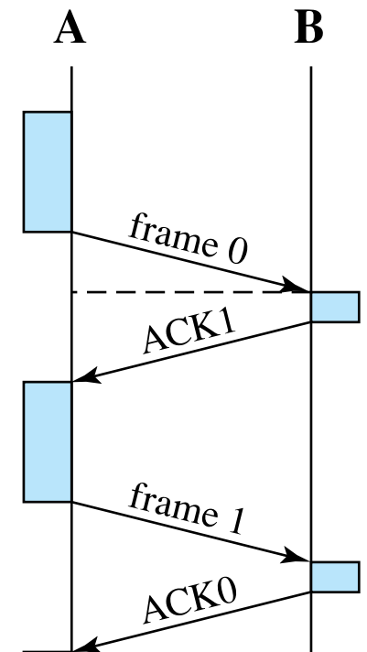
Stop and Wait Flow Control
Source:
Source transmits a DATA frame
Source waits for ACK frame before sending next DATA frame
Destination:
Destination receives DATA frame → replies back with an ACK if ready to accept more data
Destination can stop flow of data by withholding ACK

Slide 11

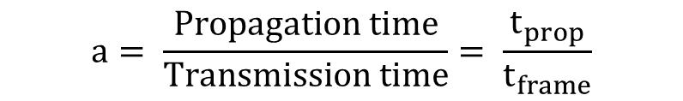
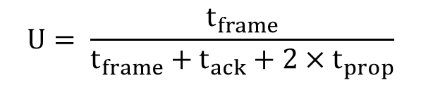
Efficiency Calculation
$$U= \frac{t_{frame}}{t_{frame}+t_{ack}+2×t_{prop}}$$
$$a= \frac{Propagation time}{Transmission time}= \frac{t_{prop}}{t_{frame}}$$

Slide 12
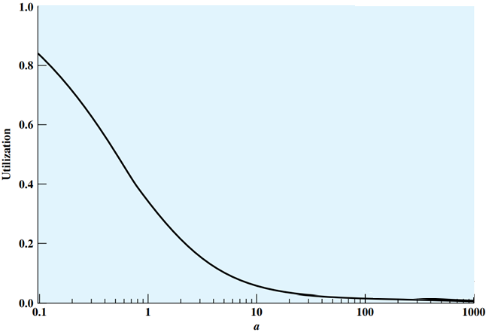
Efficiency Calculation
Stop-and-wait allows only 1 frame to be in transit at a time
Leads to serious inefficiencies especially when the frame size is small
Efficiency can be greatly improved by allowing multiple frames to be in transit at a time → which is the idea of Sliding-window flow control

Slide 13
Sliding Window Flow Control

Slide 14
Sliding Window Flow Control
Receiver allocates a buffer space of W frames
Sender can send up to W frames without waiting for an ACK
Each frame is labeled with a k-bit sequence number
Frames are numbered modulo 2^{k}
Giving max window size of up to 2^{k} – 1 (will learn during error control)
Receiver acknowledges a frame by sending an ACK (or Receiver Ready, RR)
ACK includes the sequence number of the next frame expected
ACK also implicitly says that the receiver can receive the next W frames

Slide 15
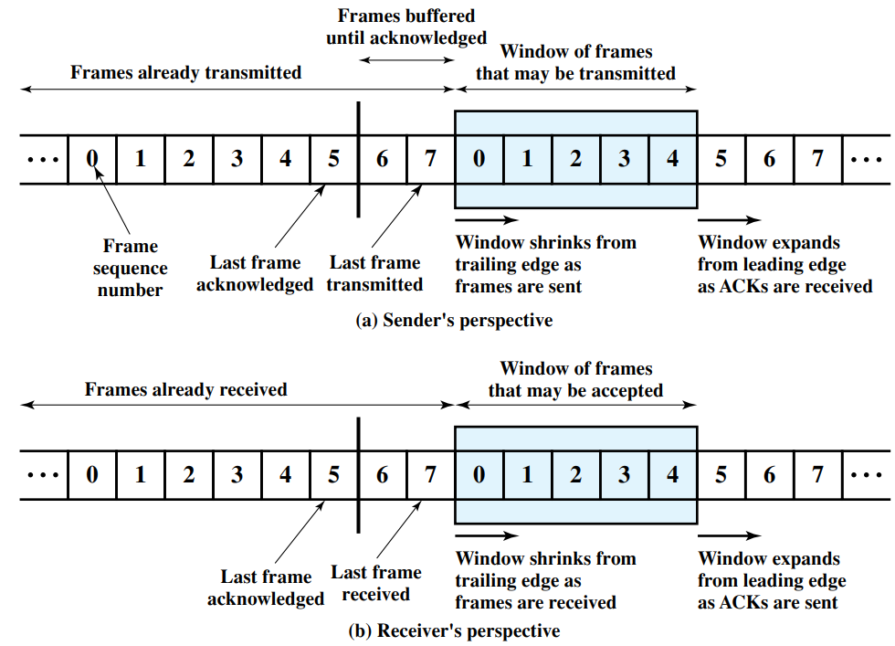
Sliding Window Flow Control

Slide 16
Sliding Window Flow Control
Sender and Receiver record:
Last frame acknowledged
Last frame transmitted (in case of sender) or received (in case of receiver)
Window of frames that may be transmitted (in case of sender) or received (in case of receiver)

Slide 17
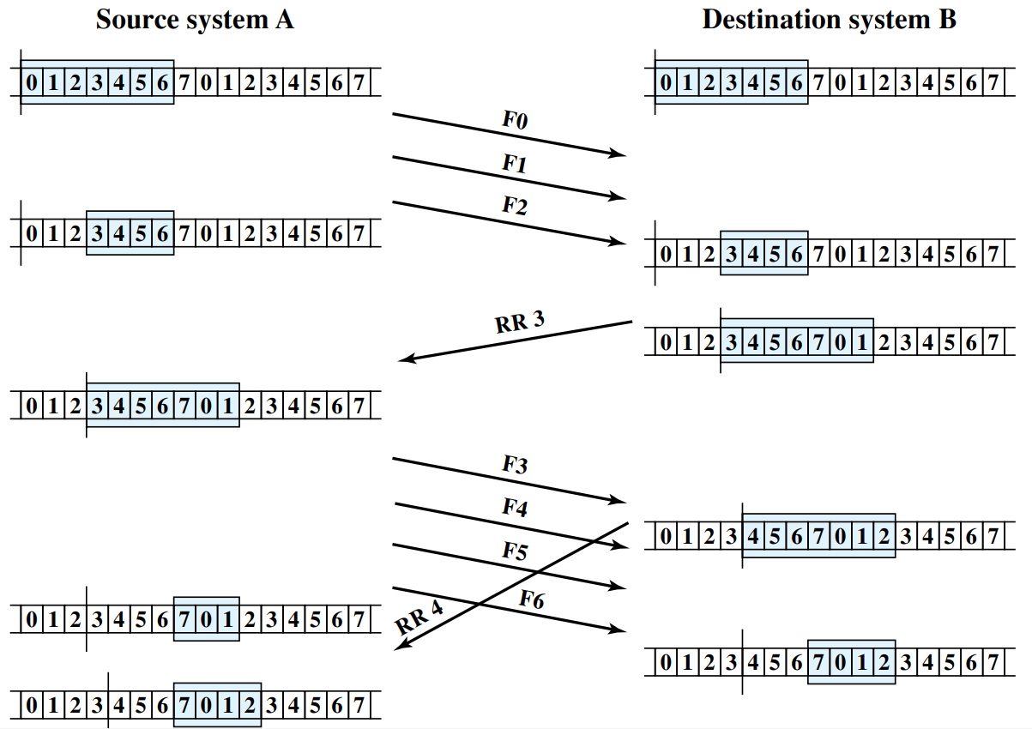
Sliding Window Flow Control: Example

Slide 18
Sliding Window Flow Control
Additional features:
Receive Not Ready (RNR): Receiver can ACK frames without permitting further transmission
RNR 5: received frames up to 4, but unable to accept any more
Must send a normal acknowledge to resume
Piggybacking: If a station has a DATA and ACK to send, it sends both together → saves communication capacity
DATA frame includes sequence number of the frame and sequence number used for ACK (i.e. next expected frame number)
If the station has an ACK but no DATA to send, it sends normal ACK (RR or RNR)
If the station has DATA to send but no new ACK → repeats the last ACK seq. no.

Slide 19
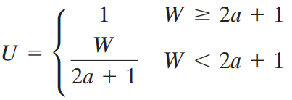
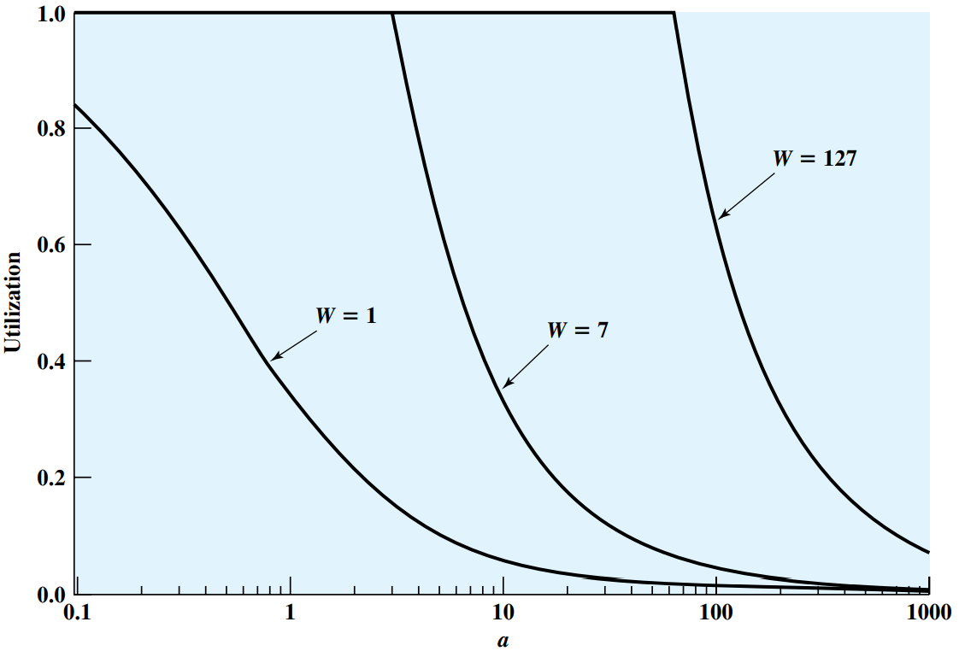
Sliding Window Flow Control

Slide 20
Summary
Link layer services
Flow control in Link Layer:
Stop and wait
Sliding window

